Slide 1
Human Cannonball Project
By: Leah Carey, CJ Stethers, and Brian Castro

Slide 2
We decided that an interesting trick for the clown company would be to launch a person over the Empire State Building. We already own a human cannonball launcher that is set at a fixed launching angle and initial velocity. Before we actually launch a person over the building, we are taking our launcher to an open field to see if a person could make it over the top of the building. Based off of the peak of its flight, we will be able to determine whether a person will safely go over the top and where the safety net needs to be placed so our person can land safely.

Slide 3
Given Information:
Launch Angle: 50 degrees
Initial Velocity: 75 m/s
Canon Height: 10 feet off the ground
Net Height: 10 feet off the ground

Slide 4
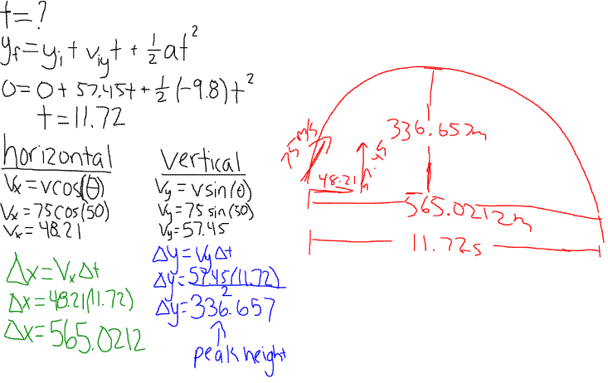
Calculations:

Slide 5
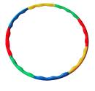
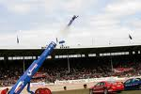
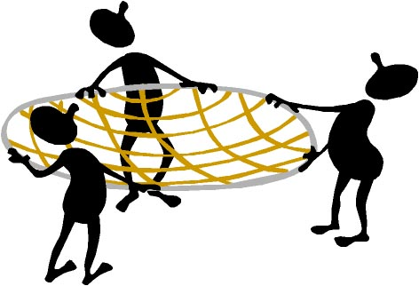
The safety net would be placed 565.0212m away and the net would be placed 282.5106m away at a height of 336.657m.

Slide 6
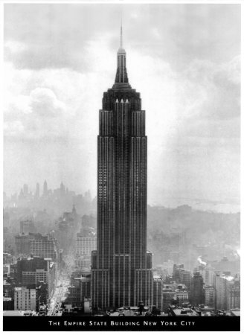
Unfortunately Gerald would go crashing through the side of the Empire State Building if we were to actually attempt to launch him over the building.

